Slide 1
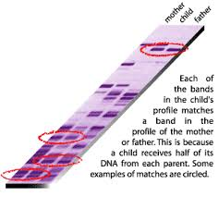
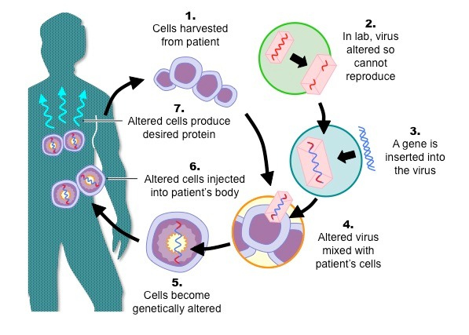
Biotechnology
DNA Fingerprinting
Gene Therapy

Slide 2
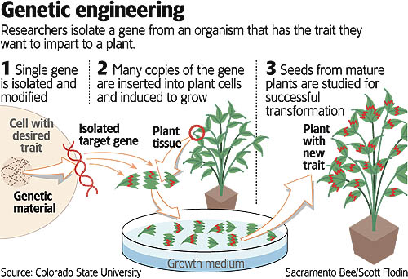

Slide 3
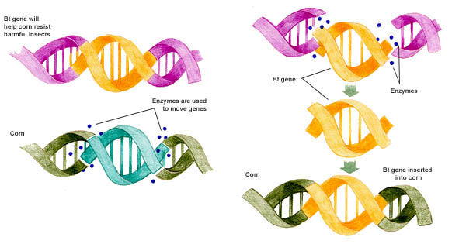
Genetic Engineering

Slide 4
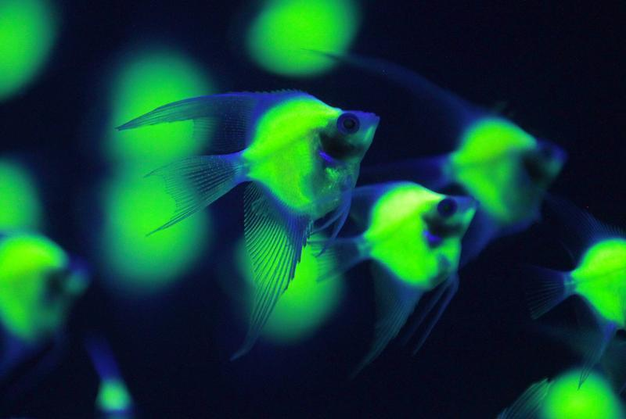
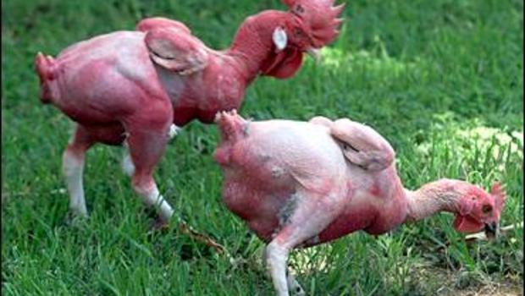
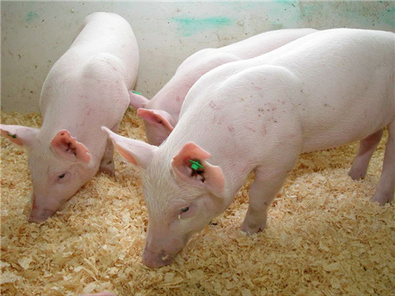
Genetically Modified Animals
Glofish- pet trade
Featherless chickens- so they do not overheat and can live in poorer countries for food.
Enviropig- Pigs produce less phosphorus in their waste. This is better for the environment.

Slide 5
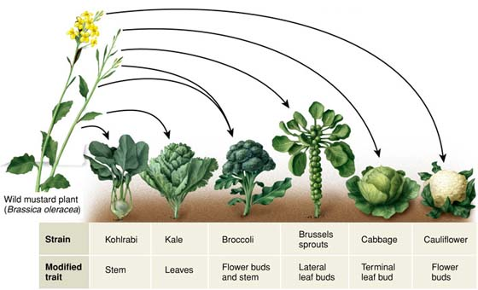
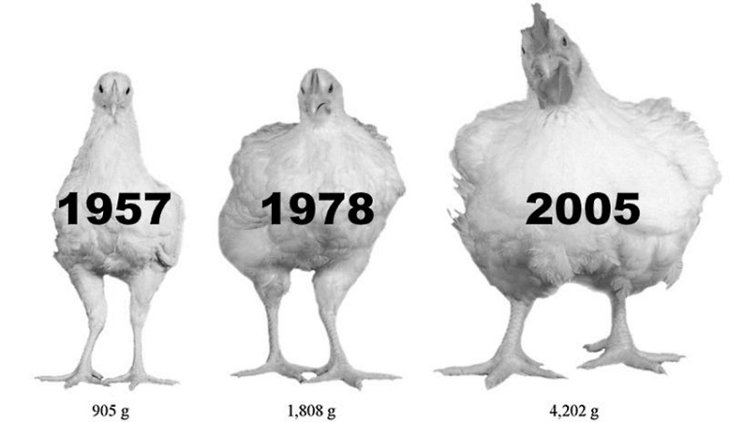
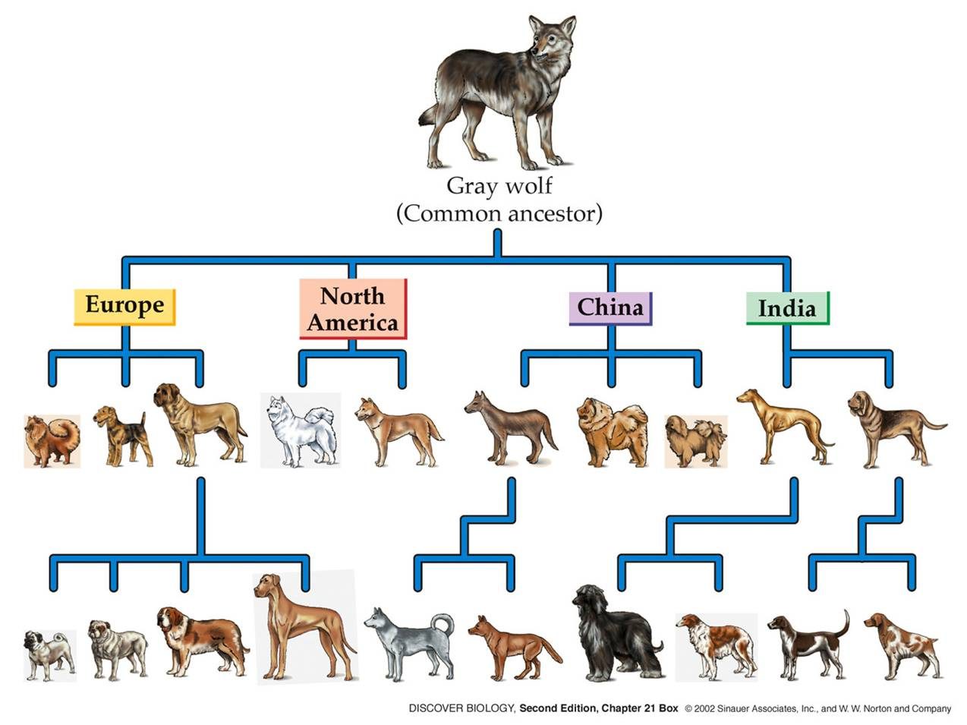
This can be called selective breeding or artificial selection

Slide 6
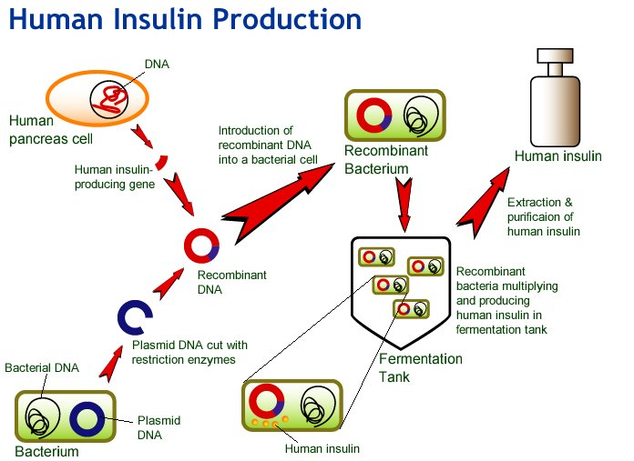
Making human proteins from bacteria

Slide 7
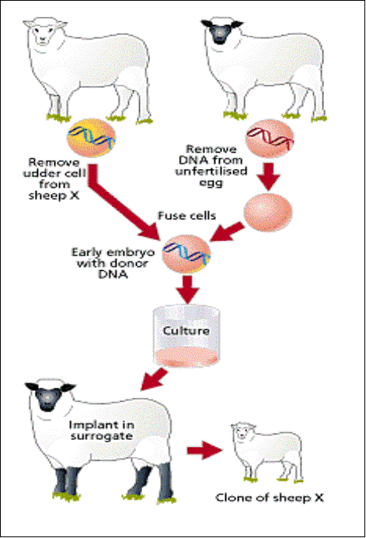
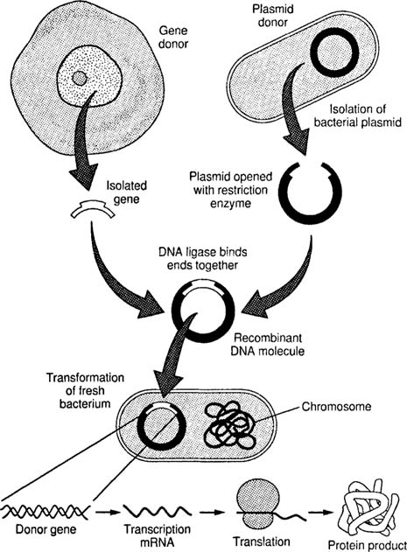
Biotechnology (continued)
Cloning
Recombinant DNA

Slide 8
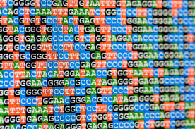
The Human Genome

Slide 9
TOPIC 7: Genetics
Gregor Mendel bred pea plants and observed their characteristics such as shape, color, etc.

Slide 10
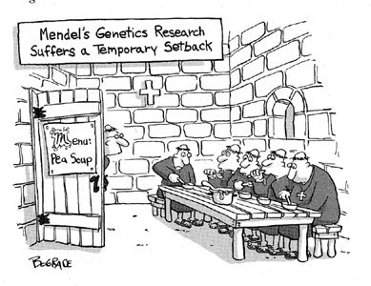

Slide 11
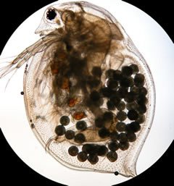
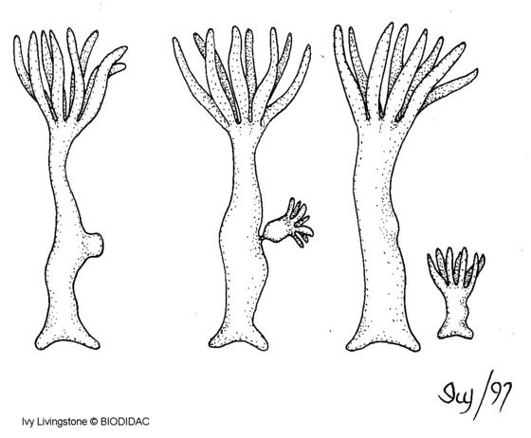
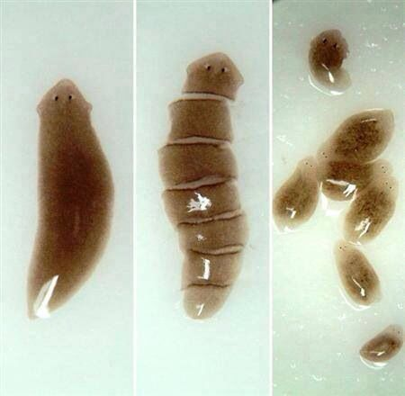
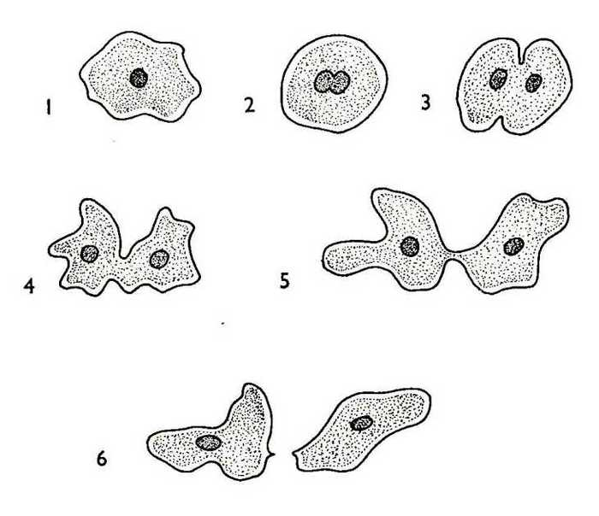
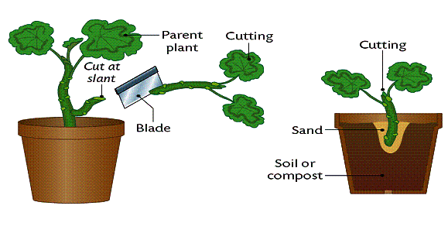
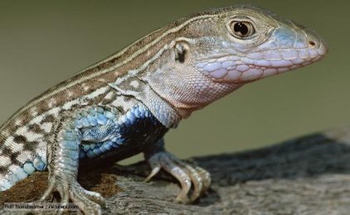
Sexual vs. Asexual Reproduction
To go through Sexual reproduction, organisms need to use meiosis to create sex cells
Asexual Reproduction-not combining genetic material from two different sexes, usually creating exact copy

Slide 12
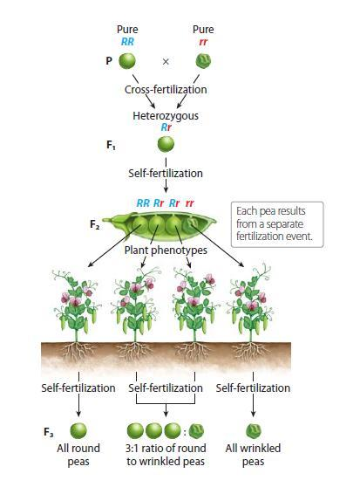
Mendel’s Research

Slide 13
Genetics VOCABULARY
Fertilization – joining male & female reproductive cells
Self pollination – pollen from one plant fertilizes egg cell from the same plant
Pure breed (true-breeding) – if self pollination produces offspring identical to the parent
Cross pollination – pollen from one plant fertilizes egg of another plant

Slide 15
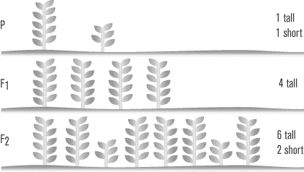
Heredity – how traits get passed from one generation to the next
GENETICS – scientific study of heredity
P generation – parent generation
F1 – first filial – offspring of the P generation
F2 – second filial – offspring of the F1

Slide 16
Dominant – allele shows up alone
Recessive – hidden allele unless there are 2
Genotype – genetic makeup (alleles)
Phenotype – physical appearance
Homozygous – 2 same alleles
Heterozygous – 2 different alleles
Y=yellow
yy=green
YY or yy or Yy
Yellow or green
yy or YY
Yy

Slide 17
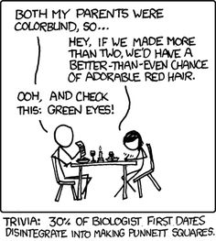

Slide 18
How to Punnett

Slide 19
Non Mendelian Patterns of Inheritance
Some alleles are neither dominant nor recessive but are controlled by other factors
Such as
Incomplete dominance
Codominance
Multiple alleles

Slide 20
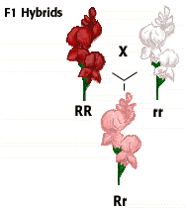
Incomplete Dominance
One allele is not dominant over the other, instead the heterozygous genotype shows an intermediate phenotype

Slide 21
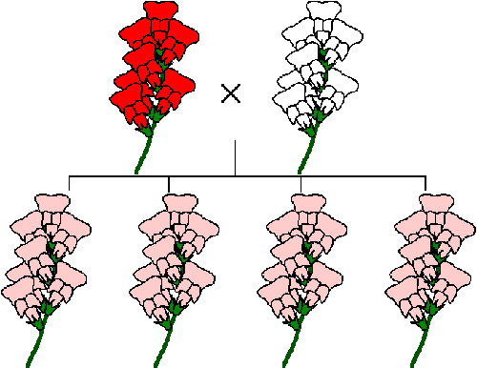
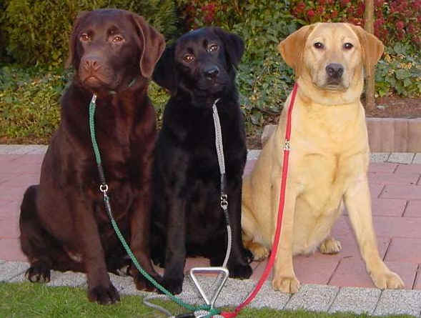
Types of Inheritance Incomplete Dominance
Traits are not dominant or recessive. The traits “blend” together to make a new color/trait.

Slide 22
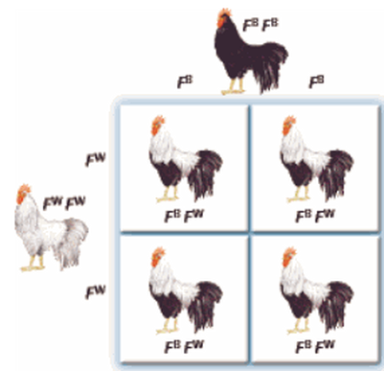
Codominance
In the heterozygous genotype, both alleles are seen

Slide 23
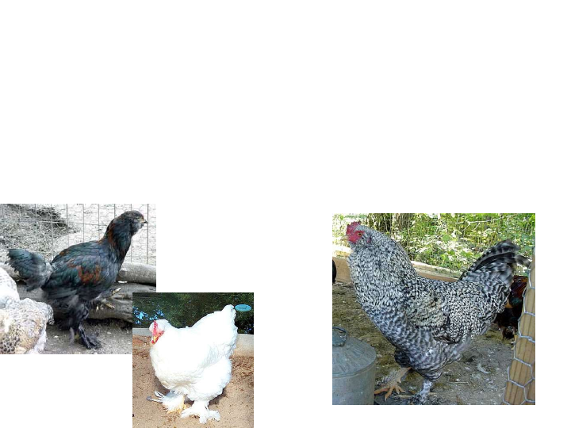
Codominance
Black Feathered Chicken
White feathered chicken
Checkered feather chicken

Slide 24
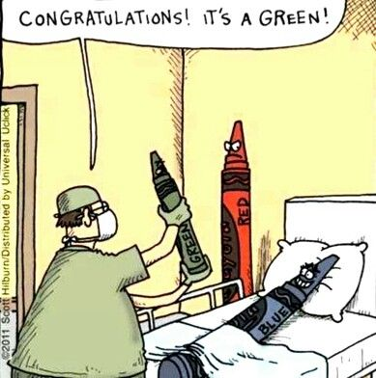
Incomplete or Codominance?

Slide 25
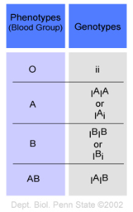
Multiple Alleles
Some genes have more than 2 possible alleles
The INDIVIDUAL only carries 2 alleles though

Slide 26
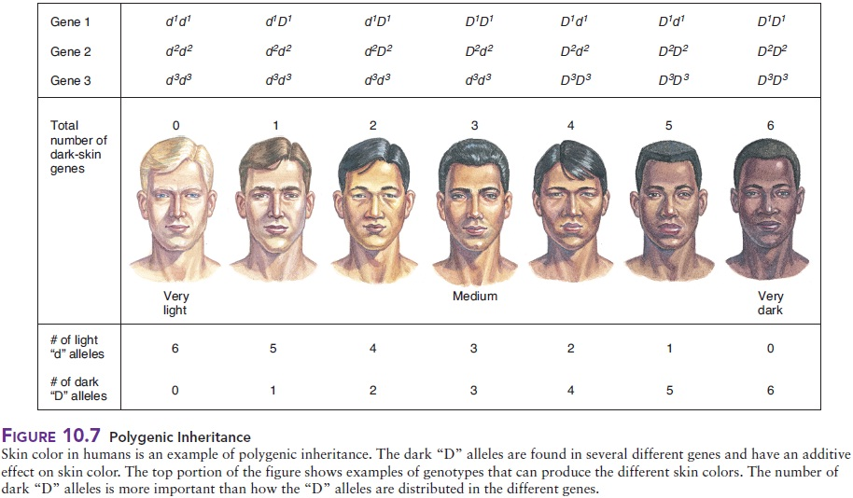
Polygenic Traits
A trait controlled by 2 or more genes with a wide variety of phenotypes

Slide 27
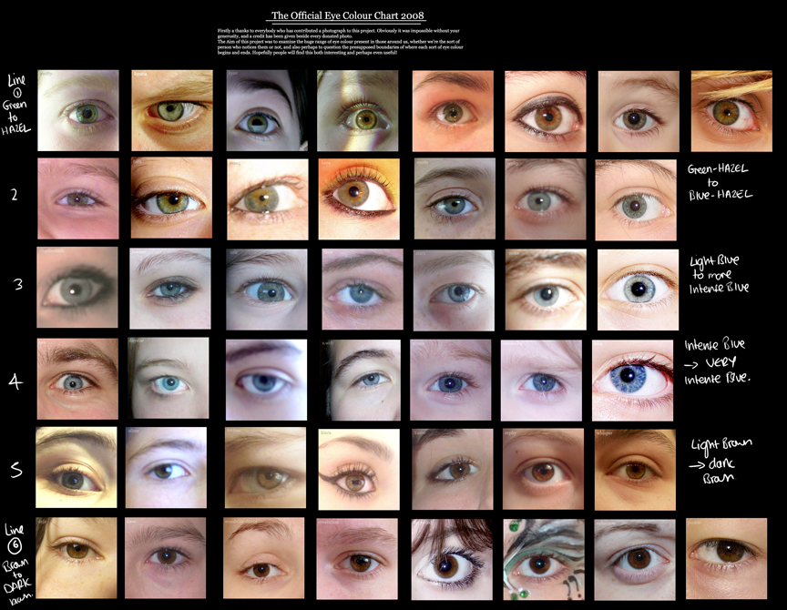

Slide 28
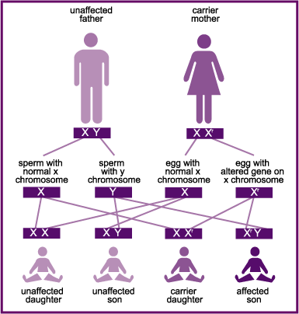
Types of Inheritance Sex-linked
The trait is carried on the sex –chromosome (x-chromosome) so the inheritance is different for males and females.
Males inherit one gene from mother on X chromosome and an unaffected Y from father.
Females inherit an X from their father and an X from their mother.

Slide 29
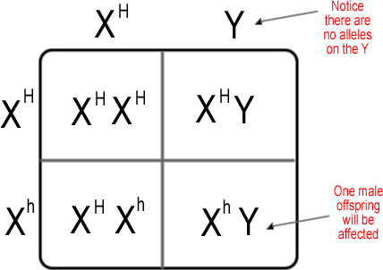
Genetics of Hemophilia
H=normal
h= hemophilia
Sex linked=only on X chromosome
More common in males? Females?

Slide 30
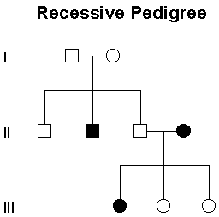
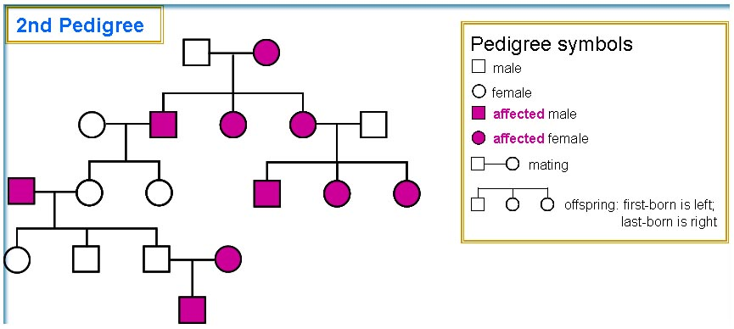
What are the genotypes of each person?

Slide 31
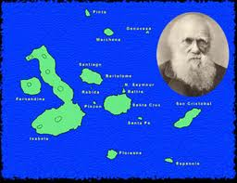
TOPIC 8: Evolution
Process of change in a species over time
Charles Darwin – theory of evolution by natural selection
Populations change in response to environmental pressures and they become adapted to new conditions and they change over time.

Slide 32
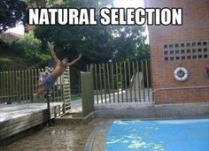

Slide 33
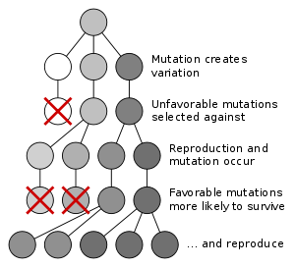
Natural Selection

Slide 34
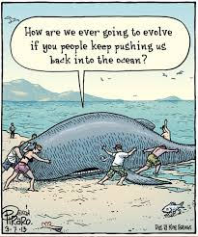
Is this how evolution happens? Think: Inherited vs. Aquired Traits

Slide 35
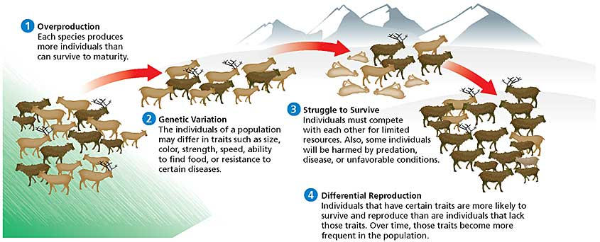

Slide 37
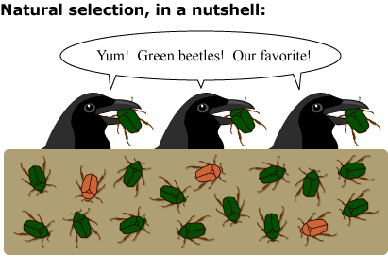

Slide 39
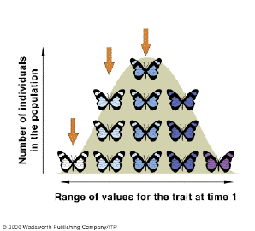
Allelic Frequency=Bell Curve

Slide 40
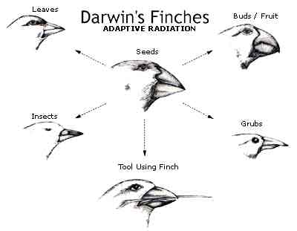
Adaptation – any heritable characteristic that increases an organism’s ability to survive and reproduce (it’s advantageous)

Slide 41
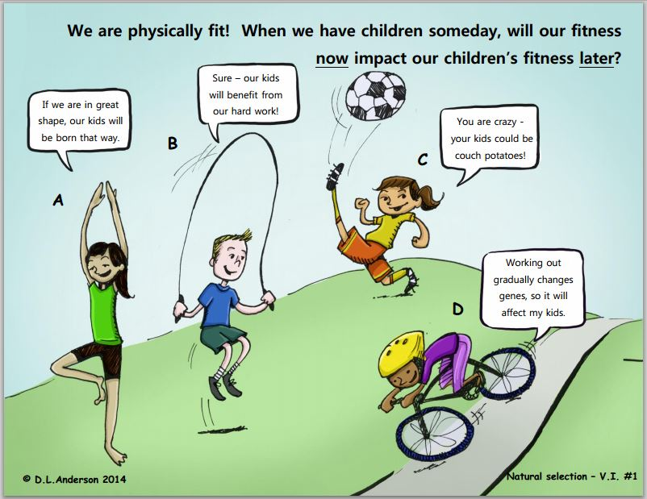

Slide 42
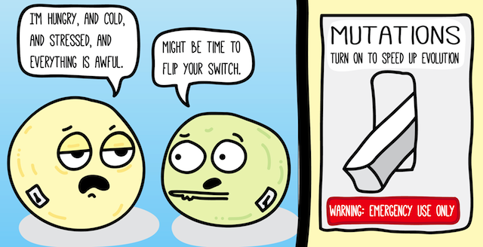
New adaptations come from mutations
Microorganisms under stress have more mutations and therefore evolve

Slide 43
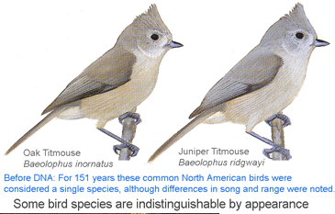
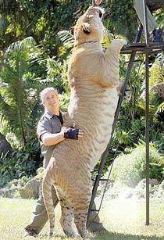
What is a speices?
Morphological Species Concept Biological Species Concept

Slide 44
Speciation

Slide 45
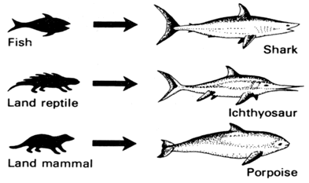
Convergent Evolution

Slide 46
Divergent Evolution-humans can cause this through selective breeding

Slide 47
Coevolution

Slide 48
Artificial Selection

Slide 49
Isolating Mechanisms
Separating 2 populations further and further until they can no longer interbreed to produce fertile offspring
Therefore going through speciation and forming a new species.

Slide 50
Geographic Isolation
Physical boundary

Slide 51
Reproductive Isolation
Occurs (one way) because species mate at different times

Slide 52
Behavioral Isolation
Differences in behavior, courtship, coloring, morphology, etc.
In the case pictured, the species became isolated by the food they became accustomed to eating.

Slide 53
Founder Effect/Bottleneck

Slide 55
Reproductive Isolation
Notes:
Horse + Donkey = Mule

Slide 56
Evidence for Evolution
Fossils
Biogeography
Homologous structures
Analogous structures
Vestigial structures
Embryology
Genetics and molecular biology

Slide 57
Fossils
Record shows that species have gradually changed over time

Slide 58
Biogeography
Distribution of life forms over a geographical area
Similar species share a common time & place

Slide 59
Homologous structures
Inherited and shared by related species

Slide 60
Analogous Structures
Body parts that share a common function but NOT a common structure

Slide 61
Vestigial Structures
Inherited from ancestors but have lost all or most of their original function
Notes:
Can mention tailbone, appendix

Slide 62
Embryology
Similar patterns of embryological development

Slide 63
Genetics and Molecular Biology
Genes nearly identical in almost all organisms

Slide 64
Similarities in Amino Acid Sequences

